Slide 1


THE AI IMPACT / 2026
ARTIFICIAL
INTELLIGENCE
THE UPSIDE.
THE TRADE-OFF.
How AI is reshaping learning, work and everyday life.
A DISCUSSION FOR AGES 18–25
HUMAN × MACHINE
Notes:
Opening (about 45 seconds): Ask the room: “Who has used AI in the past seven days?” Then ask a harder follow-up: “Was it helping you think—or deciding for you?”,This presentation is based on the supplied visual collection of AI advantages/disadvantages and the AI Insight website. The focus is a balanced discussion, not simple pro-versus-anti messaging.

Slide 2




01 / THE CONTEXT
FROM RESEARCH TO REAL LIFE
AI moved from headline-making milestones into everyday decisions.
1950
1997
2011
TODAY
THE QUESTION
THE CHESS MATCH
NATURAL LANGUAGE
GENERATIVE AI
Can a machine appear intelligent?
Deep Blue defeats Kasparov.
Watson wins Jeopardy!.
Assists with text, code and ideas.
WHERE YOU SEE IT
STUDY
CREATE
WORK
CONNECT
AI can recognize patterns and generate responses; it does not guarantee truth.
AI / OPPORTUNITY & RISK
02 / 08
Notes:
The AI Insight website highlights milestones from 1950, 1997 and 2011. The “Today” label intentionally describes the current era rather than assigning an uncertain start date to generative AI.,Ask: “Which of the four areas has AI changed most for you, and what has it made better or worse?”,Explain in simple terms that modern AI learns from data and produces predictions or outputs. Confidence and fluency are not the same as reliability.

Slide 3



02 / THE UPSIDE
THREE WAYS AI CAN EMPOWER YOU
The biggest gains come when AI extends human ability instead of replacing it.
01
02
03
LEARN
SMARTER
CREATE
FASTER
SAVE
TIME
Get another explanation, quiz yourself, or explore a problem step by step.
Experiment with ideas, drafts, images or code prototypes without starting from zero.
Summarize, organize, translate and automate repeatable tasks—then review the result.
USE IT FOR: PRACTICE & FEEDBACK
USE IT FOR: ITERATION & IDEAS
USE IT FOR: FIRST DRAFTS
AI / OPPORTUNITY & RISK
03 / 08
Notes:
Learning: AI can provide alternate explanations and practice, but students should still retrieve and apply knowledge independently.,Creativity: it can help overcome a blank page, yet people still set intentions, make choices and evaluate originality.,Productivity: the time saved can be significant on some tasks, but outputs need checking. Avoid presenting unverified percentages.,Discussion prompt: “At what point does AI help you learn less, even when it helps you finish faster?”

Slide 4
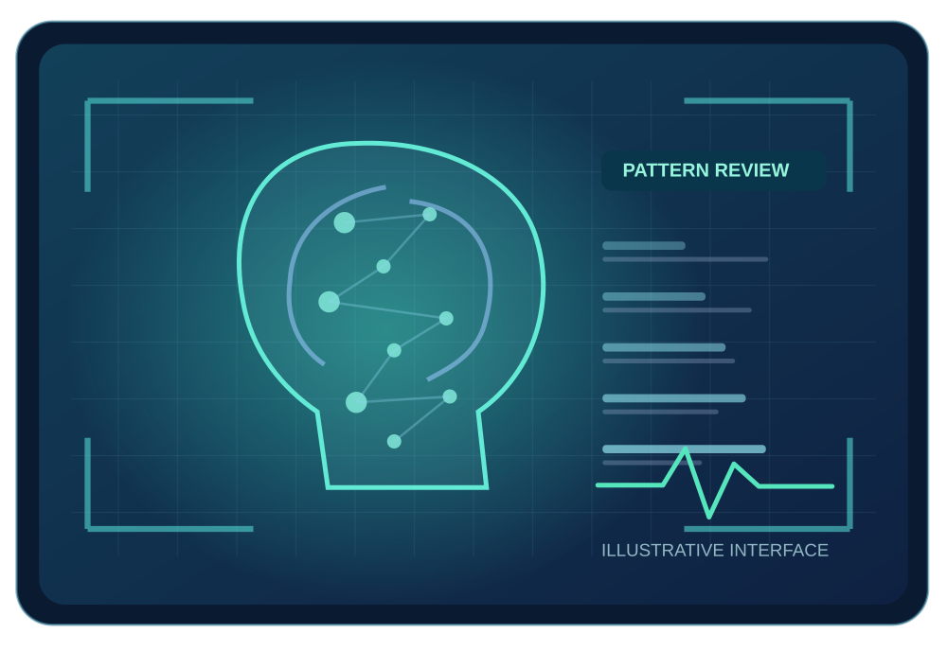



03 / BEYOND THE INDIVIDUAL
AI CAN MAKE A BIGGER DIFFERENCE
Real applications can support experts and remove barriers—but are not infallible.
SCIENCE & RESEARCH
HEALTHCARE
Discover patterns in complex datasets and test possible explanations.
AI can help professionals identify patterns in medical images and focus their review.
ACCESSIBILITY
ILLUSTRATION
SUPPORTS CLINICIANS ≠ REPLACES THEM
Captions, translation and assistive interfaces widen participation.
AI / OPPORTUNITY & RISK
04 / 08
Notes:
Healthcare: describe AI as decision support rather than an autonomous doctor. The illustrated interface is deliberately stylized and is not a clinical image.,Science: AI can help detect statistical relationships, but models and findings need human validation and replication.,Accessibility: captions, speech interfaces and translation may reduce barriers. Actual quality can vary by language, accent, device and situation.,The supplied AI Insight page mentions healthcare, school support and future work; its highly specific unsourced performance claims were not repeated.

Slide 5





04 / THE DOWNSIDE
WHEN AI GETS IT WRONG
Four risks can turn a useful tool into a source of real harm.
MISINFORMATION
PRIVACY
A fluent answer, image or video can be misleading or entirely fabricated.
Personal or confidential information can be exposed through careless use.
BIAS & UNFAIRNESS
SCAMS & SECURITY
A system trained on skewed data may repeat unequal patterns.
AI can make phishing, impersonation and deception more convincing.
THE PROBLEM: SOMETHING CAN LOOK CONVINCING WITHOUT BEING VERIFIED.
AI / OPPORTUNITY & RISK
05 / 08
Notes:
The uploaded board highlights wrong decisions, cybersecurity threats, privacy, misinformation and bias. These are discussed as risks, not as universal outcomes.,Misinformation: use the word “hallucination” if the audience knows it; AI-generated citations can be fabricated.,Privacy: do not enter other people’s personal data or confidential records into tools unless authorized and the service is approved.,Bias: removing sensitive group labels is not necessarily enough, because other data can act as a proxy.,Harder audience question: “Can a tool be highly accurate on average and still be unacceptable for an important decision?”

Slide 6
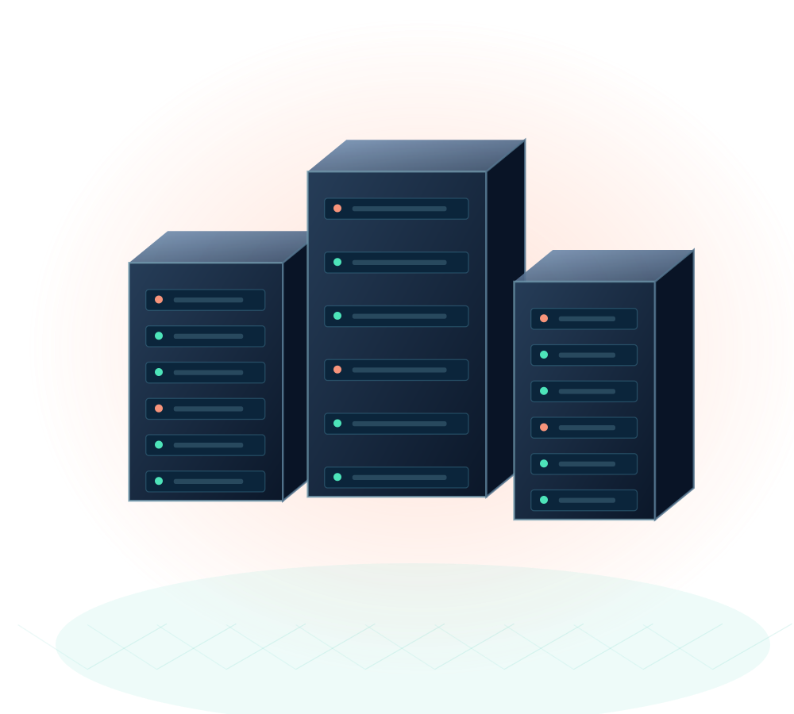



05 / THE TRADE-OFF
THE HIDDEN COST OF CONVENIENCE
Faster outputs do not remove the impact on people, skills or resources.
WORK & OPPORTUNITY
Some tasks are automated; others change. Benefits and disruption are not shared equally.
HUMAN SKILLS
Over-dependence can reduce practice in critical thinking, creativity and independent problem-solving.
ENERGY & COST
Advanced systems require computing power, infrastructure and ongoing investment.
WHO BENEFITS?
WHO CARRIES THE COST?
AI / OPPORTUNITY & RISK
06 / 08
Notes:
The supplied board lists job loss, high development costs, reliance on AI, reduced human skills and environmental impact.,Do not claim that all jobs will disappear. It is more accurate to describe effects on tasks, professions, access and distribution.,AI infrastructure consumes energy and materials. The total impact depends on model design, scale of use, local electricity mix and efficiencies.,Prompt: “If a tool saves you five hours a week, what skills might you lose—and which new skills could you gain?”

Slide 7

06 / MAKE THE CALL
YOU ARE THE DECISION-MAKER
A realistic dilemma with no risk-free answer.
WHAT SHOULD HAPPEN NEXT?
HYPOTHETICAL CASE
A
PAUSE AND AUDIT
THE HIRING
ALGORITHM
Prioritize fairness; accept possible delays.
B
CONTINUE WITH SAFEGUARDS
A company uses AI to rank internship applicants. The shortlist arrives quickly, but one group appears less likely to be selected. The cause is still unclear.
Use human review and independent checks.
C
LIMIT AI TO ADMIN TASKS
Avoid automated rankings; do more manual work.
Which option would you defend—and what evidence might change your mind?
AI / OPPORTUNITY & RISK
07 / 08
Notes:
Interactive segment (2–3 minutes): Have participants choose A, B or C, and then defend their choice in pairs.,All choices have trade-offs. A reduces immediate fairness risk but delays a potentially useful process. B preserves some efficiency but safeguards may fail. C limits the system’s role but consumes more resources.,Follow-up: “Who should be accountable for a biased decision: the vendor, the employer, the human reviewer, or all three?”,Ask what evidence would change a decision: subgroup error rates, audit findings, appeals procedures, legal requirements and a comparison with human-only processes.

Slide 8





06 / THE TAKEAWAY
USE AI.
KEEP YOUR JUDGMENT.
Five habits for responsible AI use
VERIFY
01
PROTECT
02
QUESTION
03
Check facts, claims and sources.
Keep sensitive information private.
Notice bias and missing perspectives.
DISCLOSE
04
PRACTICE
05
Be open about meaningful AI assistance.
Keep strengthening your own skills.
THE FINAL QUESTION
Where should humans always have the final say?
Adapted from the supplied AI visual board and AI Insight HTML. Unverified statistics omitted.
08 / 08
Notes:
Close by emphasizing agency, not fear: AI can amplify people while also amplifying mistakes, bias and misuse.,These five habits turn broad risks into daily practice. For work or education, also follow any local policies on use and disclosure.,Closing round: Ask participants to name one task they would confidently delegate to AI and one decision they believe requires a human final say.,SOURCES: visual AI positives/negatives collection and AI Insight website supplied with the task. Several precise claims in the webpage were unsourced, so this deck does not repeat them as verified figures.

